Slide 1

Electricity demand and price forecasting
- Yatharth Khanna khannayatharth82@gmail.com

Slide 2
Contents
Problem Statement
Data Introduction
Exploratory Data Analysis
Feature Engineering
Visualization
Model Implementation
Comparison of Model
Conclusion

Slide 3
Problem Statement
This project explores the use of machine learning to predict both electricity demand and price.
The goal is to support smart grid operations and facilitate data-driven decision-making in the energy market.
Datasets provided: Weather Dataset – Contains weather details with historical data and relevant features. Energy Dataset – Contains the historical load usage and generation of electricity.
Outcomes: Improved Demand Forecasting Enhanced Price Prediction Data-Driven Insights

Slide 4
Data Introduction
Weather Dataset: Dataset Size: (178396,17). Timestamp: ‘dt_iso’ . The columns includes: Temperature Precipitation Additional Weather Data
Energy Dataset: Dataset Size: (35064,27). Timestamp: ‘time’ . The columns includes: Energy Generation Sources Hydro Generation Renewable and Other Generation Forecasts Load and Price Data

Slide 5
Exploratory Data Analysis
Merging the data -
Initially the data contains weather data : (178396, 17) Energy data : (35064, 27)
After aggregating the weather data columns with date and time column weather data : (35064, 14)
Merged the two datasets with date and time column merged data : (35064, 41)

Slide 6
Exploratory Data Analysis
Missing values imputation – Missing values is replaced using ffill and bfill after identifying the number of missing values from each column.
Outlier detection and replacement – Identify Outliers:
Calculate Q1 (25th percentile) and Q3 (75th percentile)
Compute IQR (Interquartile Range):
IQR=Q3−Q1
Define bounds: Lower=Q1−1.5×IQR, Upper=Q3+1.5×IQR
Replaced the outliers with median value of the respective columns.

Slide 7
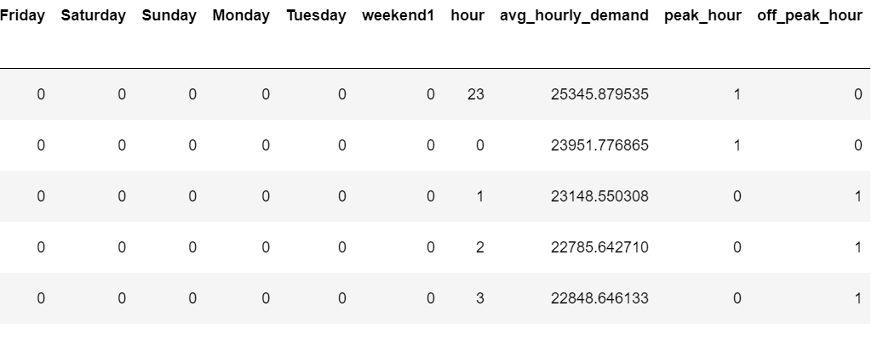
Feature Engineering
Columns Created: month day weekday weekend hour weekend
Average Hourly Demand: Calculate avg_hourly_demand by hour.
Peak/Off-Peak Classification: Create peak_hour and off_peak_hour based on avg_hourly_demand.

Slide 8
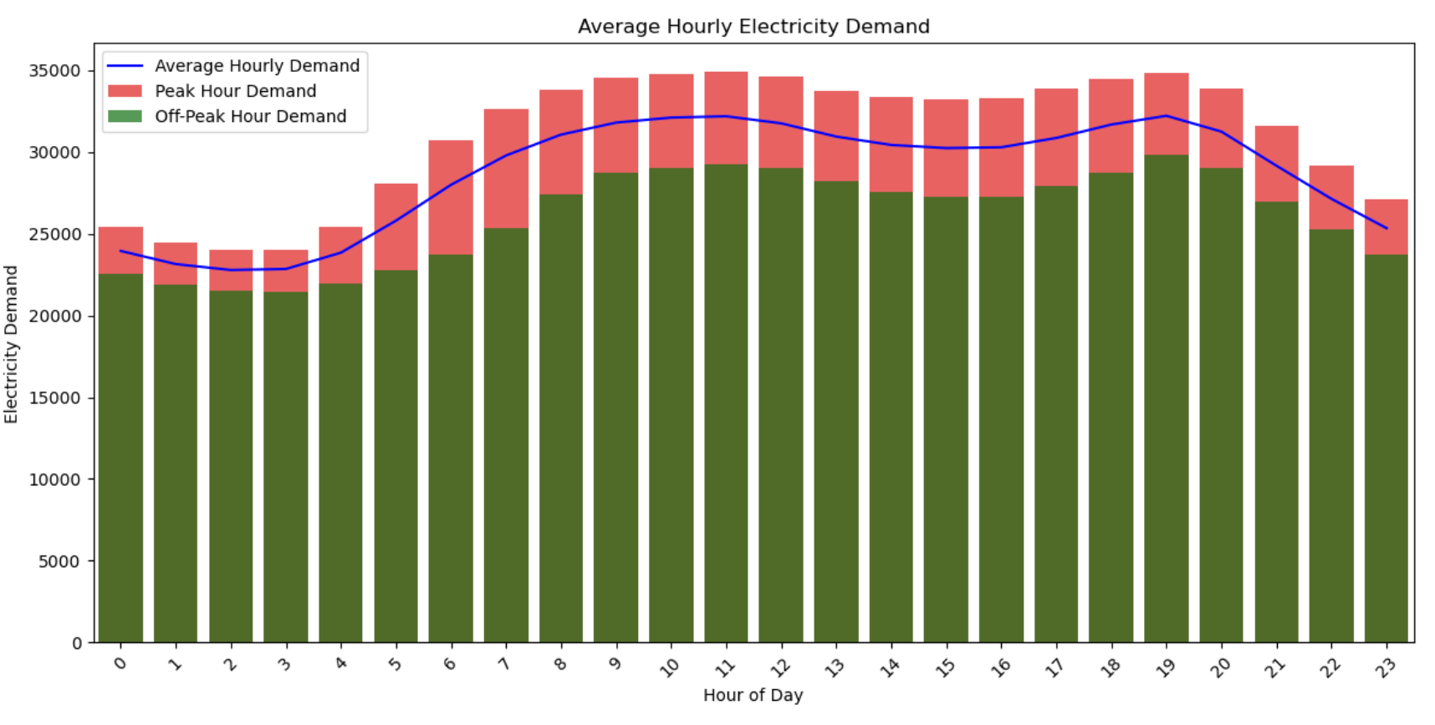
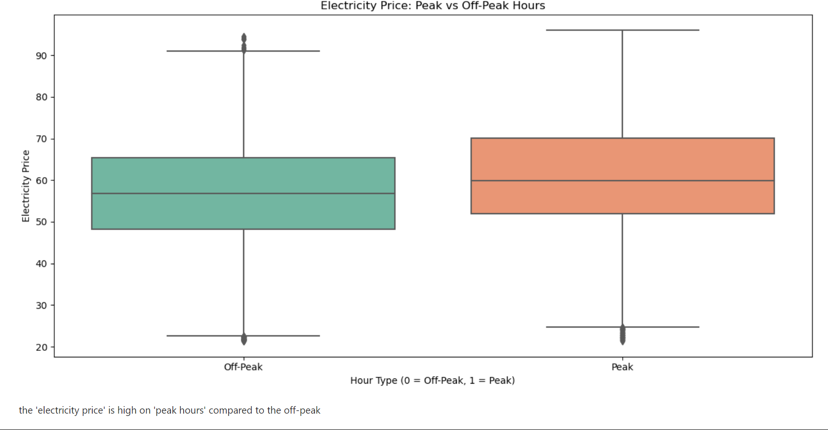
Visualization
Average hourly demand for peak and off-peak hours
'electricity demand ' : 'average hourly demand' is only on 'peak hours' only
the 'electricity price' is high on 'peak hours' compared to the off-peak

Slide 9
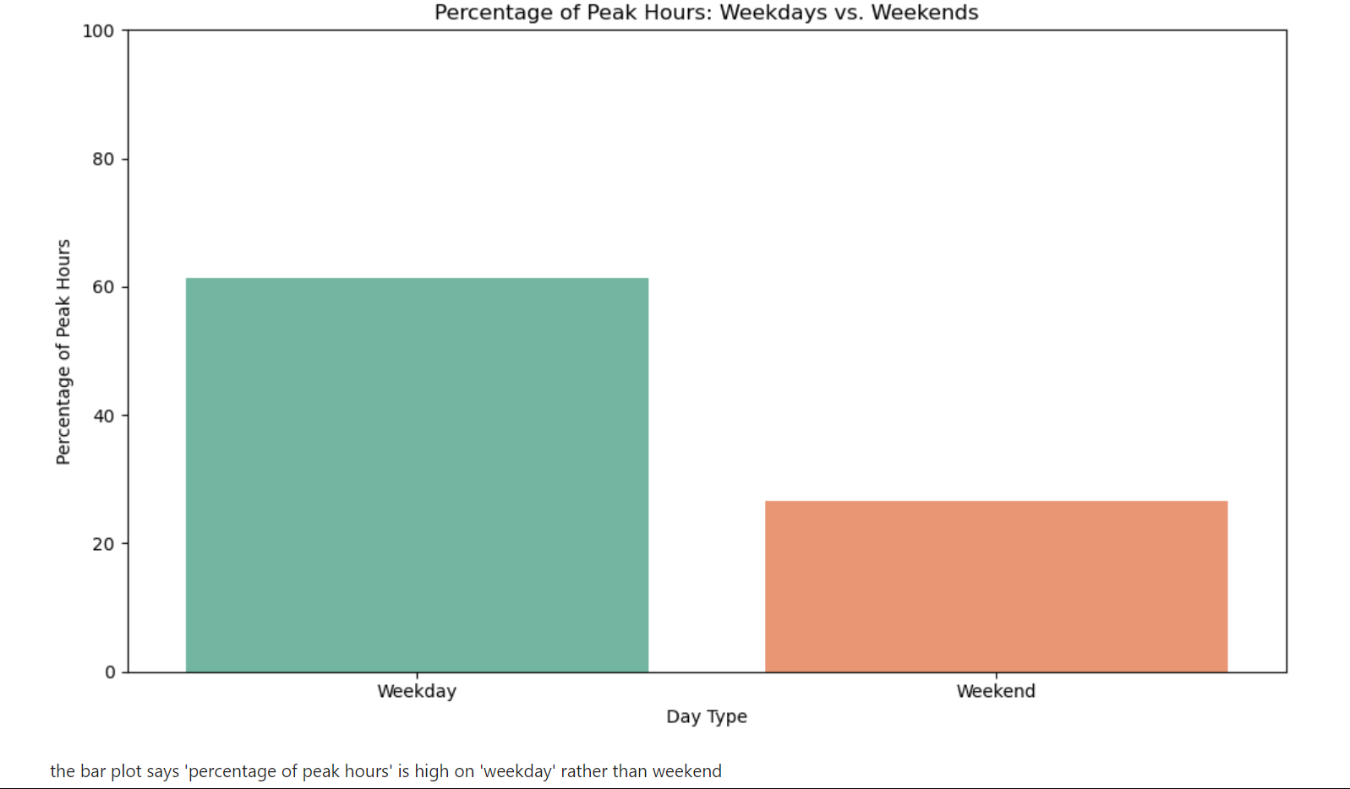
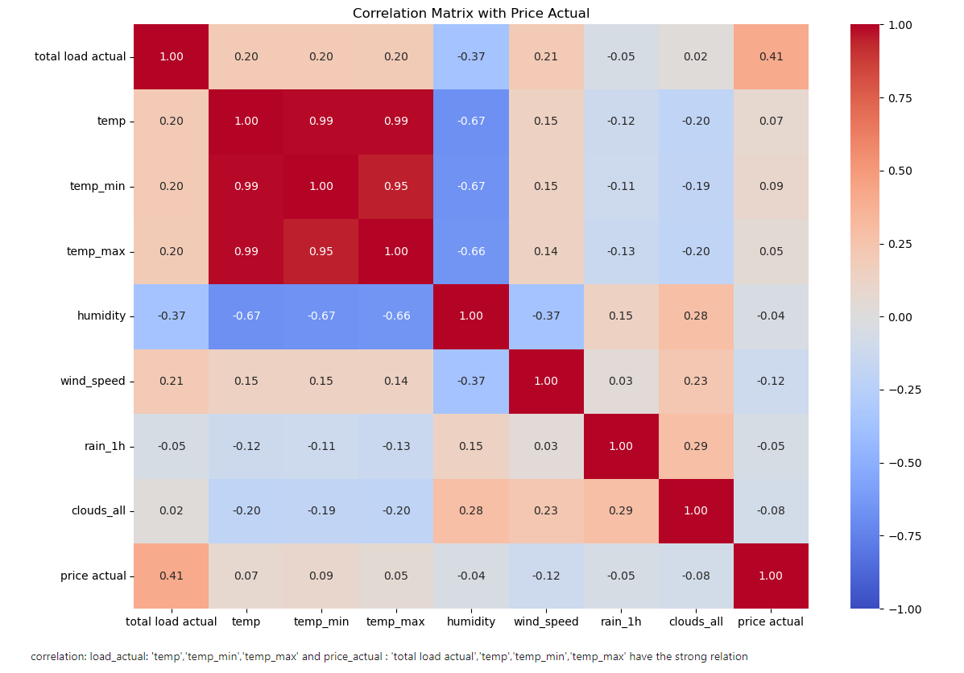
Visualization
Percentage of peak hours on weekday and weekends
correlation Matrix
the bar plot says 'percentage of peak hours' is high on 'weekday' rather than weekend
'temp','temp_min','temp_max’ has strong relation

Slide 10
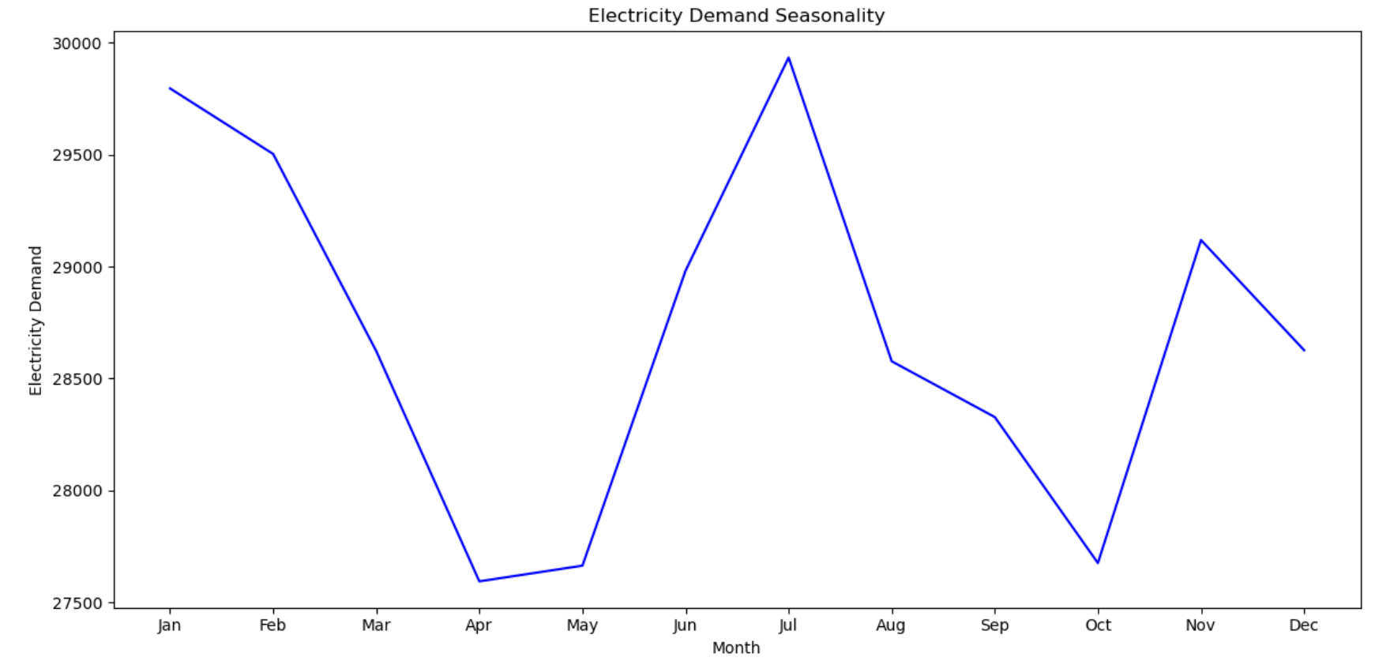
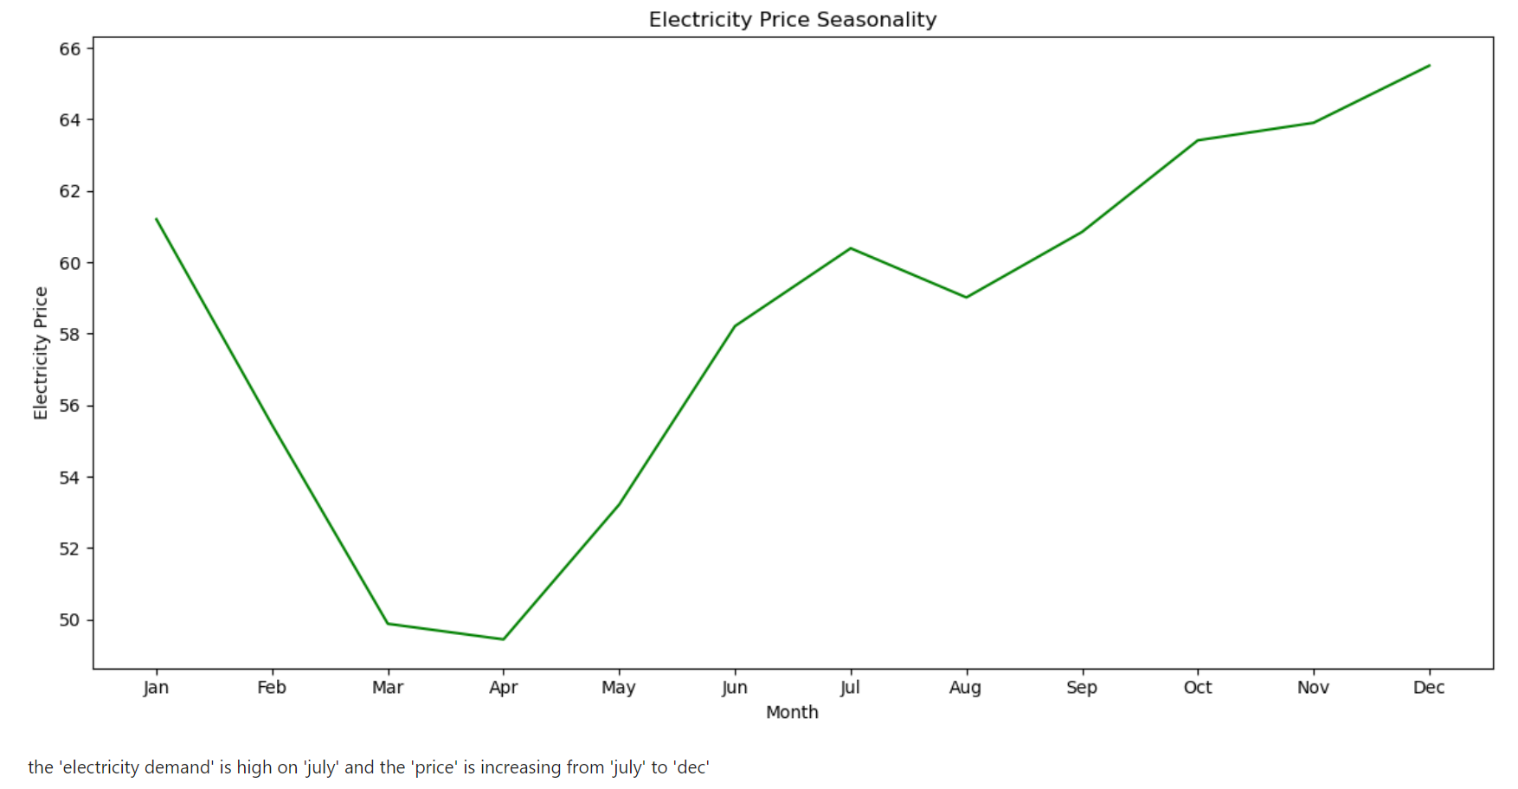
Visualization
Demand over seasonality
the 'electricity demand' is high on ‘July' and the 'price' is increasing from ‘July' to 'dec'

Slide 11
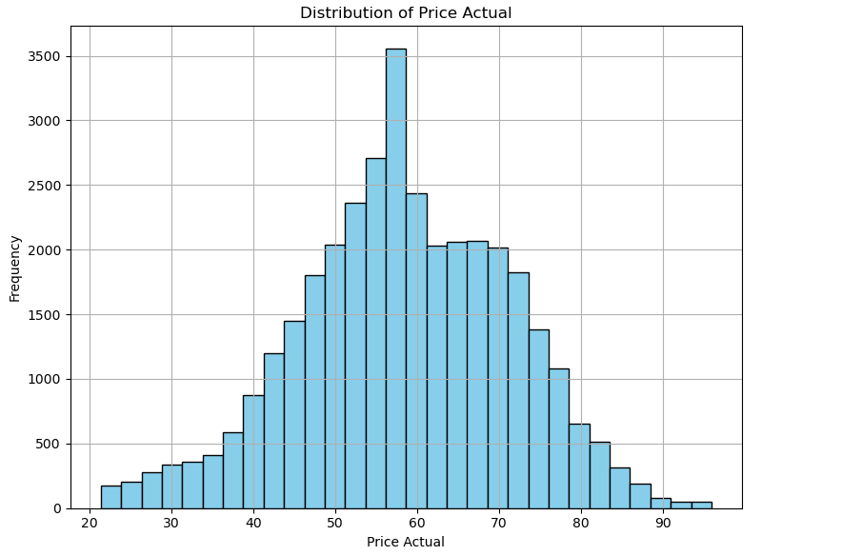
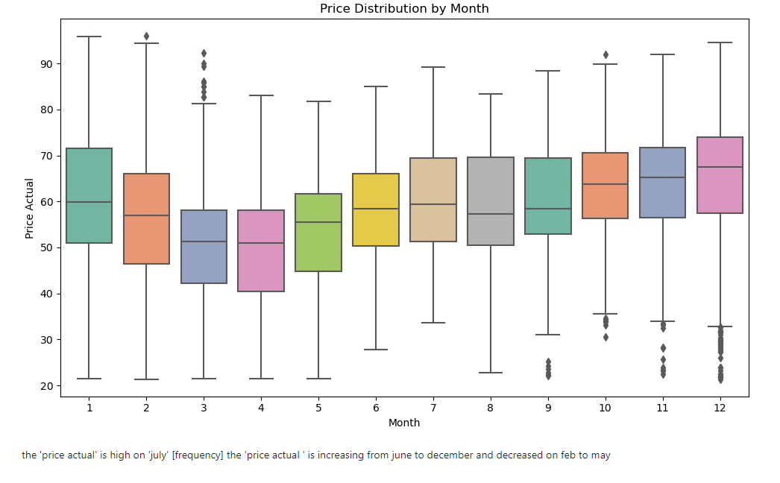
Visualization
Histogram for price actual
Box plot for price actual
the 'price actual' is high on ‘July'
the 'price actual ' is increasing from June to December and decreased in Feb. to may

Slide 12
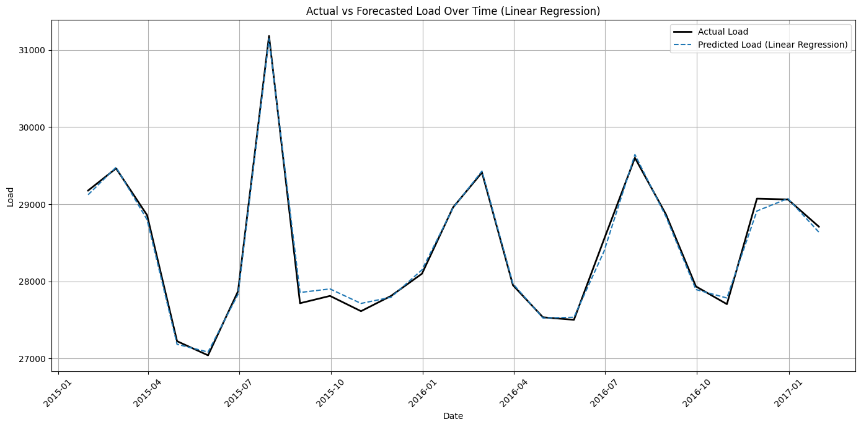
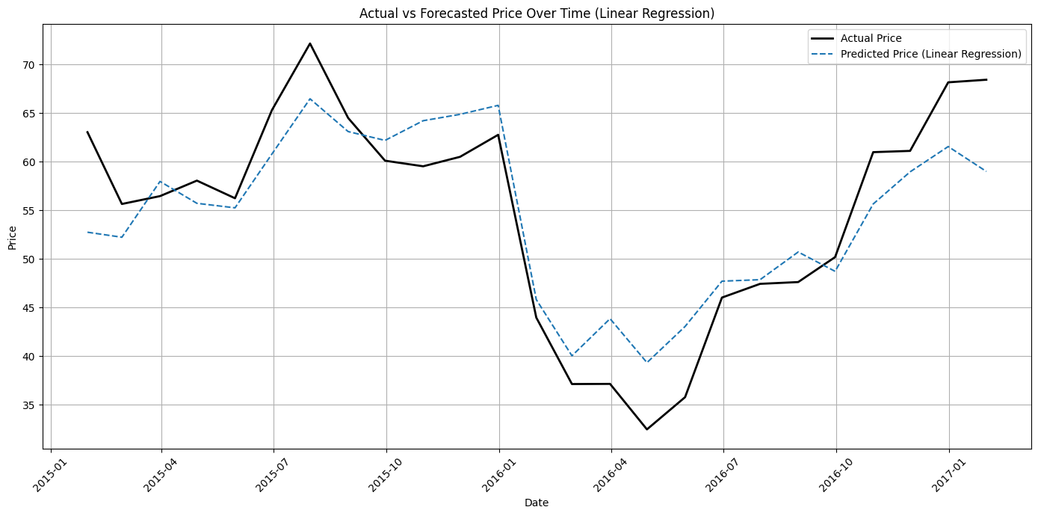
Model Implementation – linear regression
For Load Actual
For Price Actual

Slide 13
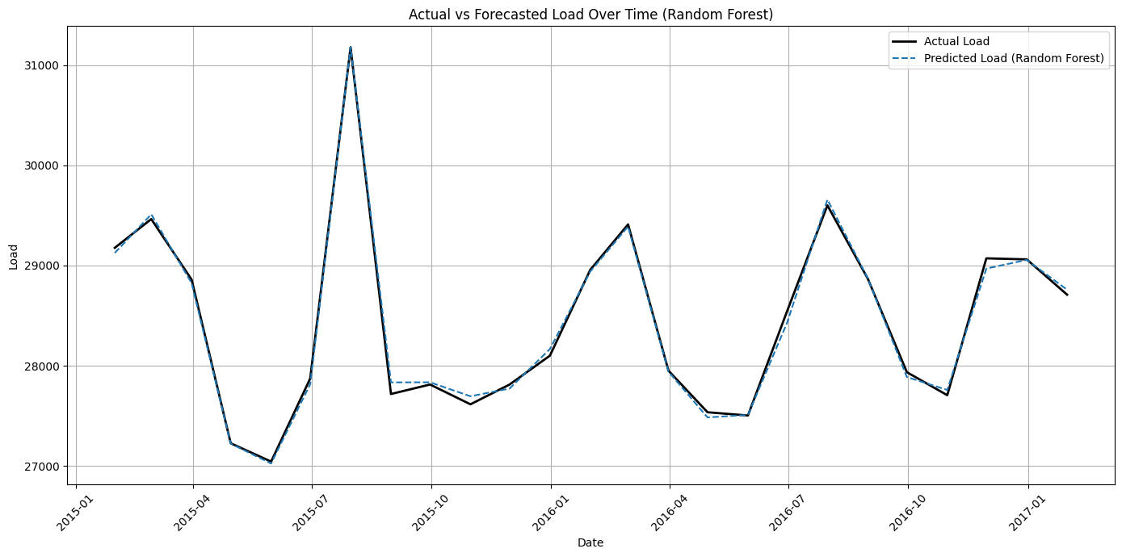
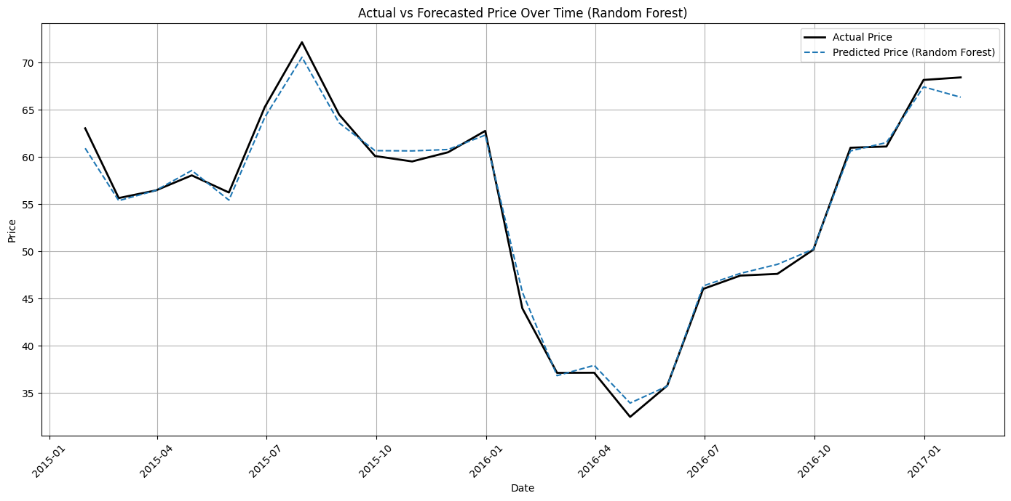
Model implementation – Random forest
For Load Actual
For Price Actual

Slide 14
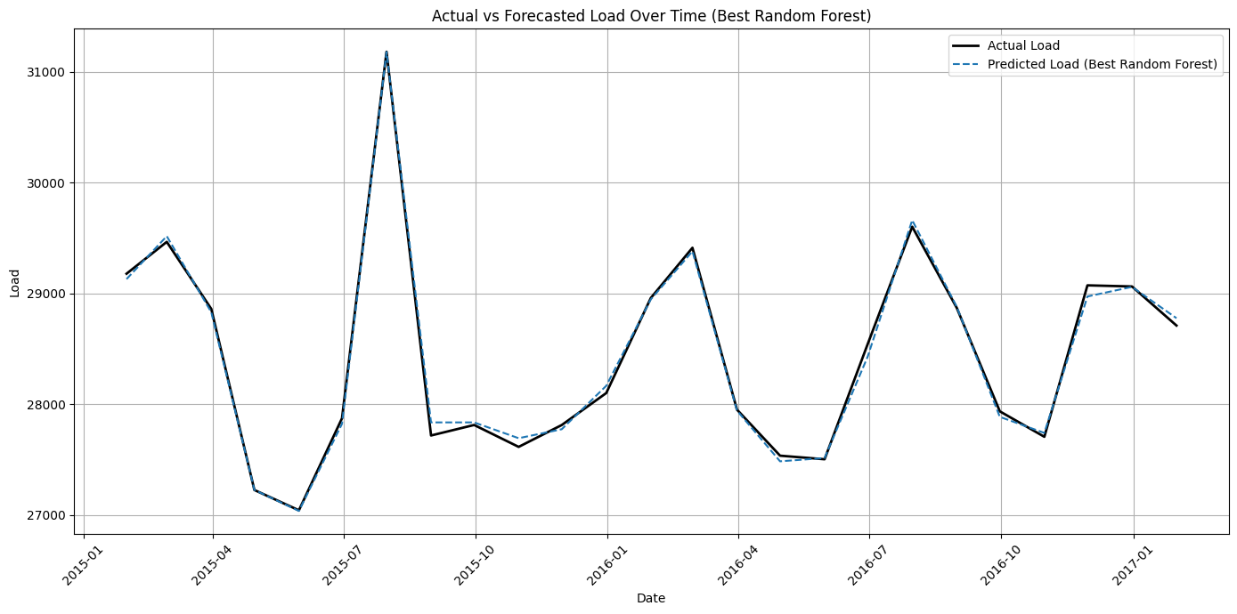
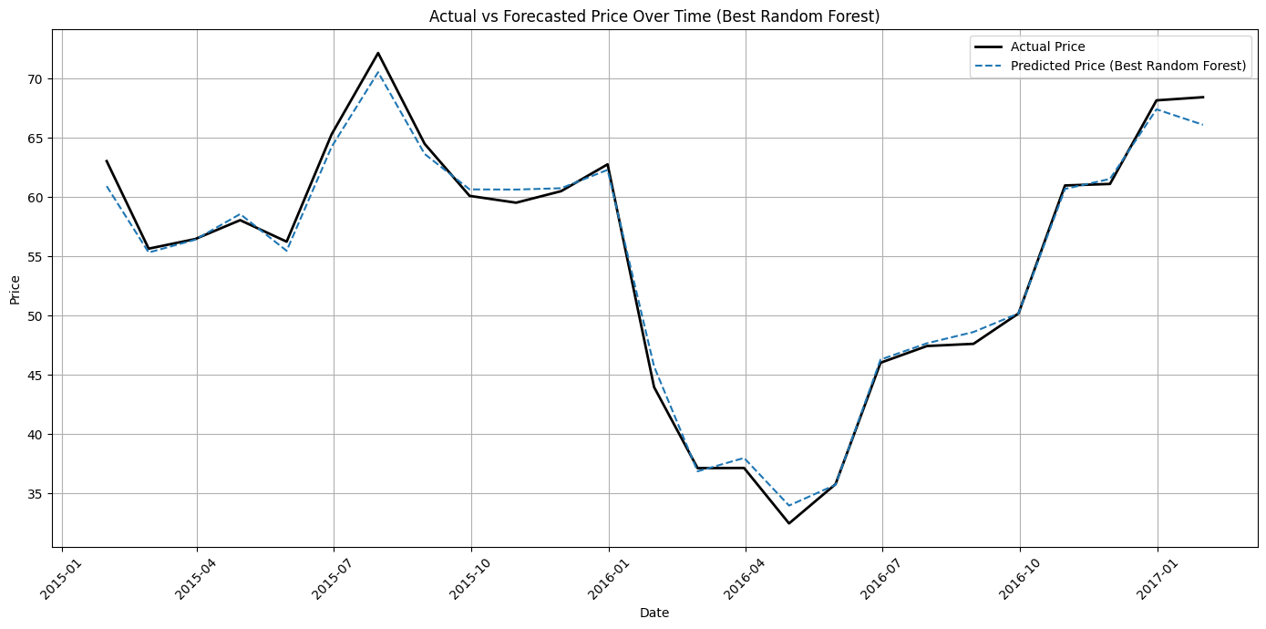
Random forest with hyper parameter tuning
For Load Actual
For Price Actual

Slide 15
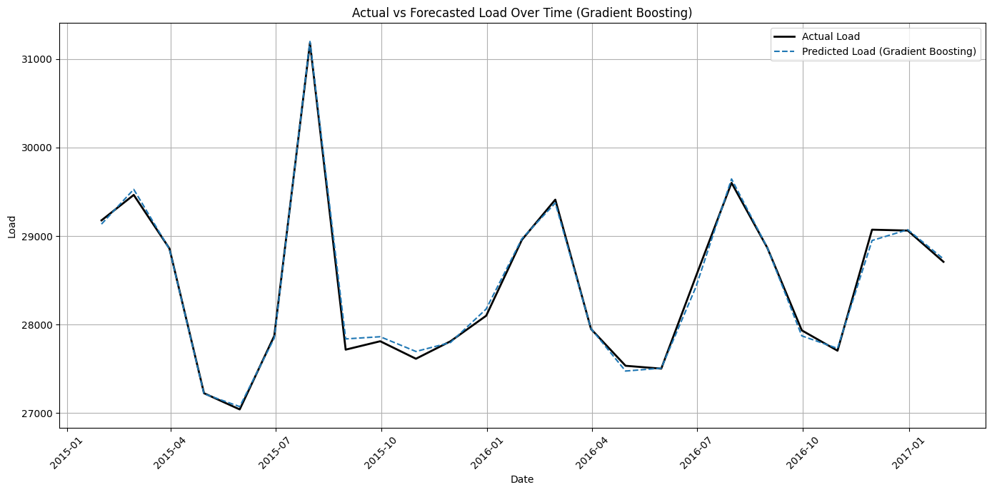
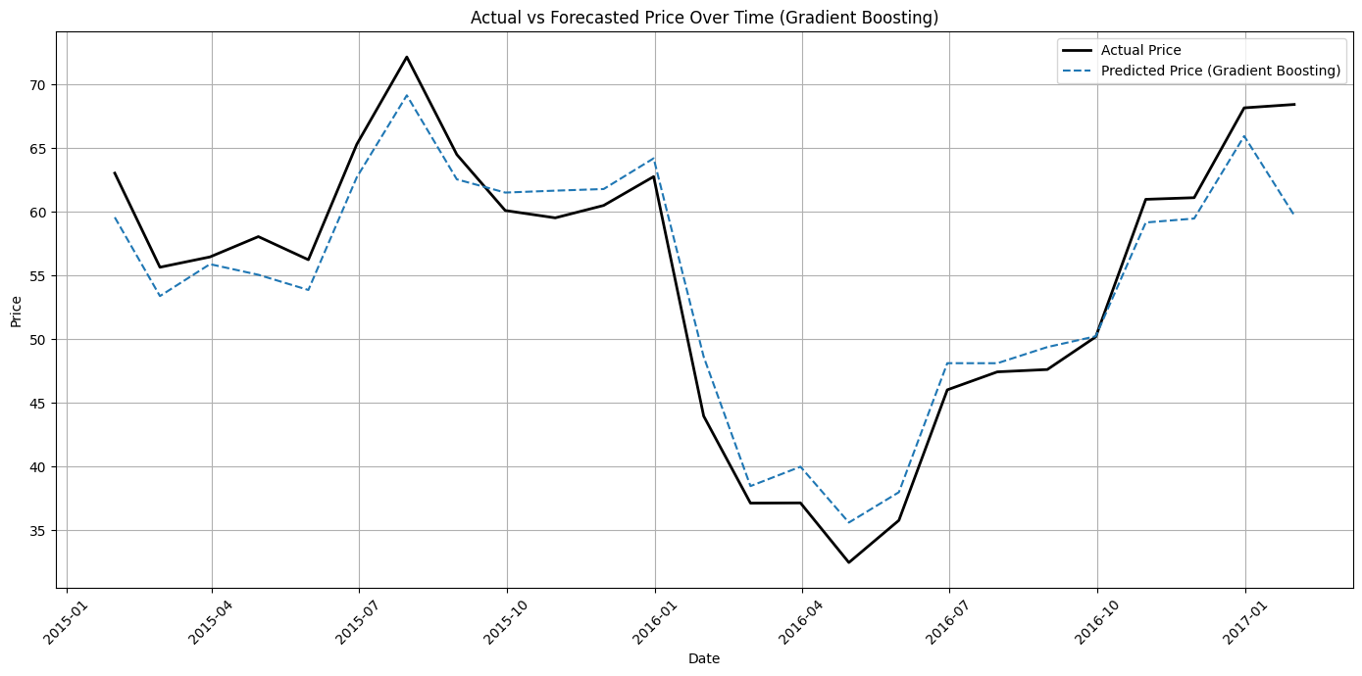
Gradient Boosting Regressor
For Load Actual
For Price Actual

Slide 16
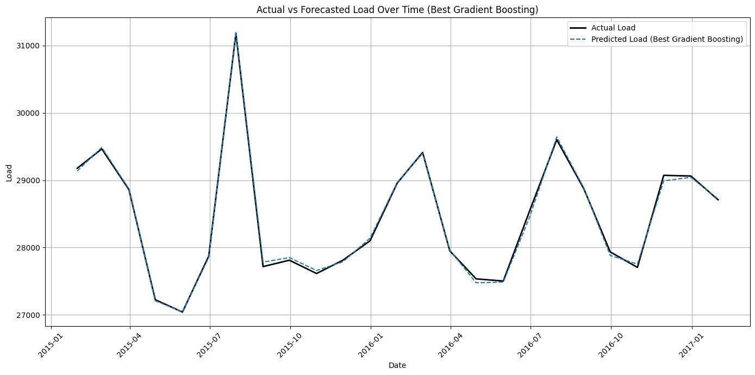
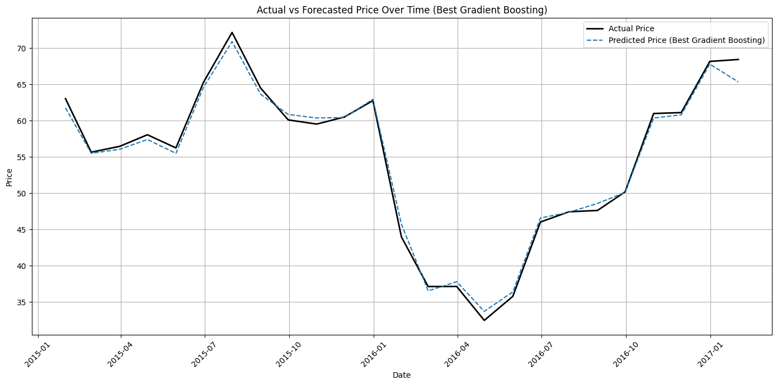
Gradient Boosting with hyper parameter tuning
For Load Actual
For Price Actual

Slide 17
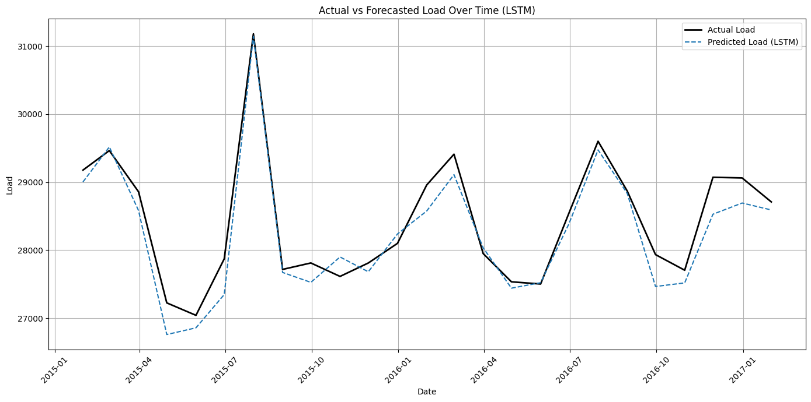
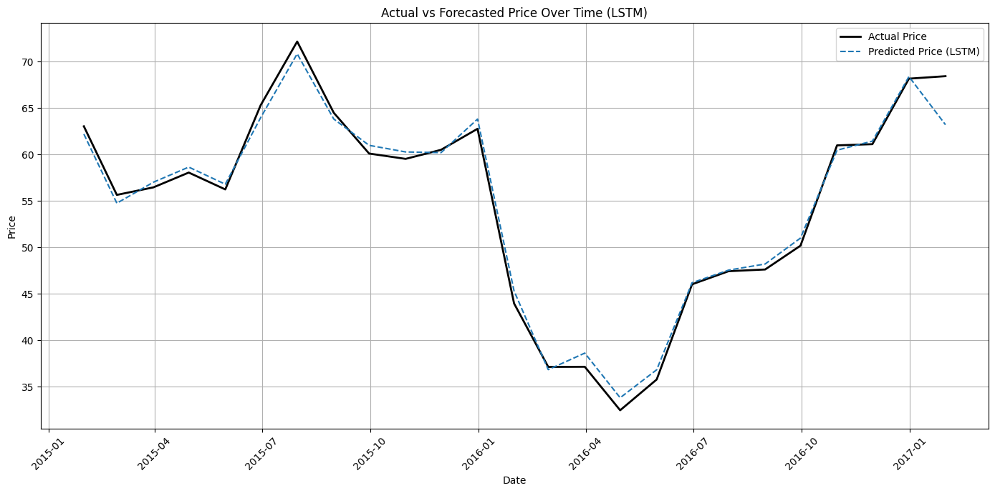
Long short - term memory
For Load Actual
For Price Actual

Slide 18
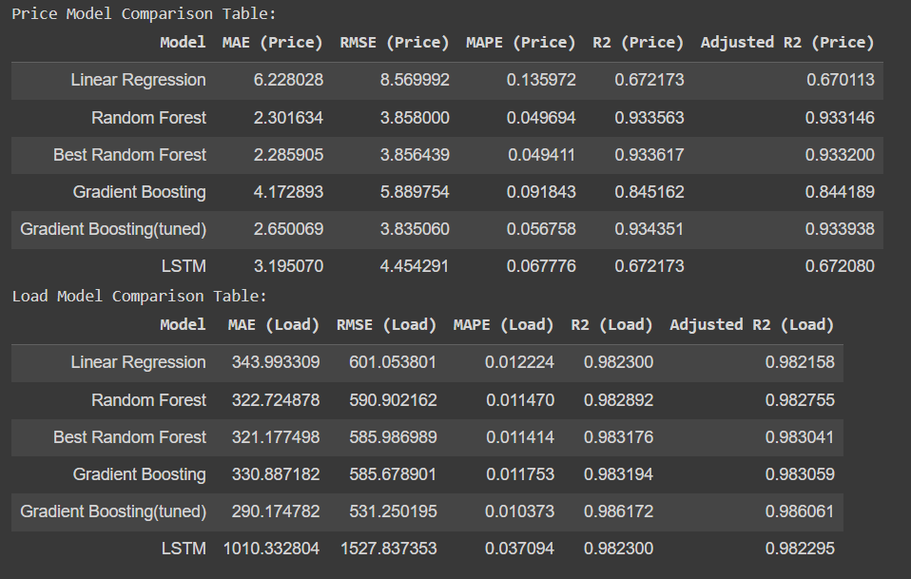
Comparison of Model

Slide 19
conclusion
Predicting Energy Load
For predicting the energy load (total load actual), we experimented with various models including Linear Regression , LSTM, Random Forest Regressor, and Gradient Boosting Regressor.
Here are the key points:
Gradient Boosting Regressor: This model showed superior performance in terms of R2 score, capturing non-linear relationships between weather features and energy load effectively.
The Gradient Boosting Regressor with hyperparameter tuning was chosen as the best model for predicting energy load due to its ability to handle complex interactions between features and its robustness to overfitting.
Predicting Energy Price
For predicting the energy price (price actual), we tested models including Linear Regression, Random Forest Regressor, and Gradient Boosting Regressor.
The notable findings are:
Random Forest Regressor: This model with appropriate hyperparameter tuning outperformed others by providing better R2 scores and capturing the trend in price variations accurately.
The Random Forest Regressor with hyperparameter tuning was selected as the best model for predicting energy price due to its strong performance in handling the non-linear and seasonal trends in the data. Additionally, it showed good generalization on the test set, indicating its robustness.

Slide 20


